Slide 1


Computer Architecture Spring 2020
Hamed Farbeh
farbeh@aut.ac.ir
Department of Computer Engineering
Amirkabir University of Technology

Slide 2
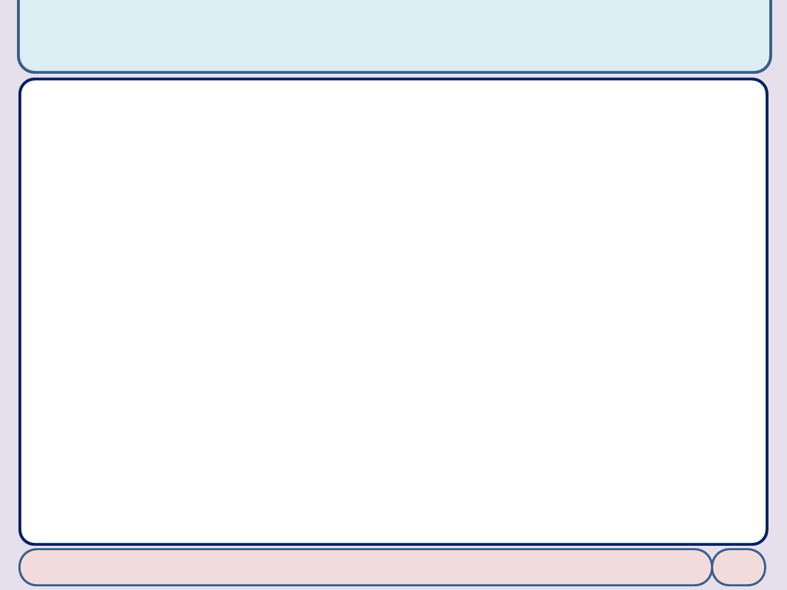

Copyright Notice
Lectures adopted from
Computer Organization and Design: The Hardware/Software Interface, 5th edition, David A. Patterson, John L. Hennessy, MK pub., 2014
Chapter 5: Large and Fast: Exploiting Memory Hierarchy
Computer Architecture, Spring 2020, AUT, Tehran, Iran

Slide 3
Associative Caches
Fully associative
Allow a given block to go in any cache entry
Requires all entries to be searched at once
Comparator per entry (expensive)
n-way set associative
Each set contains n entries
Block number determines which set
(Block number) modulo (#Sets in cache)
Search all entries in a given set at once
n comparators (less expensive)
Computer Architecture, Spring 2020, AUT, Tehran, Iran

Slide 4
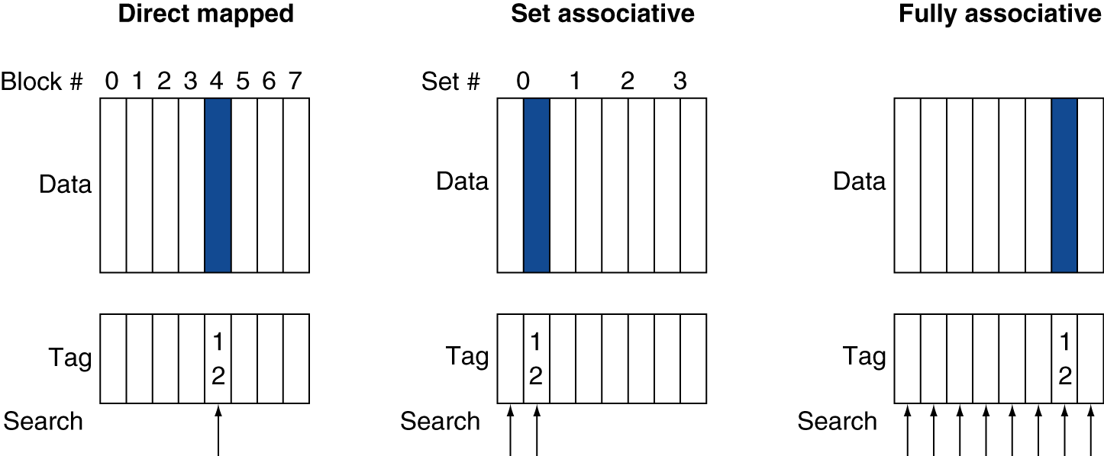
Associative Cache Example
Computer Architecture, Spring 2020, AUT, Tehran, Iran

Slide 5
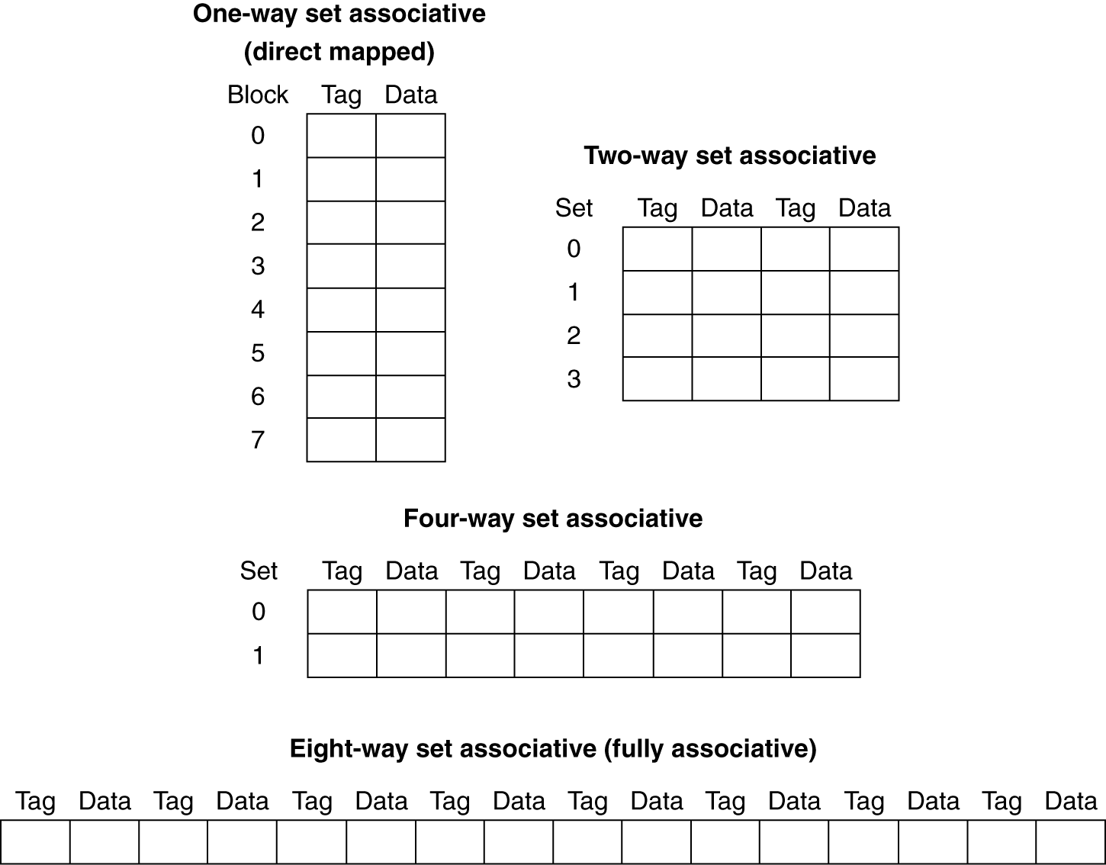
Spectrum of Associativity
For a cache with 8 entries
Computer Architecture, Spring 2020, AUT, Tehran, Iran

Slide 6
Associativity Example
Compare 4-block caches
Direct mapped, 2-way set associative, fully associative
Block access sequence: 0, 8, 0, 6, 8
Direct mapped
Block address | Cache index | Hit/miss | Cache content after access
 |  |  | 0 | 1 | 2 | 3
0 | 0 | miss | Mem[0]
8 | 0 | miss | Mem[8]
0 | 0 | miss | Mem[0]
6 | 2 | miss | Mem[0] |  | Mem[6]
8 | 0 | miss | Mem[8] |  | Mem[6]
Computer Architecture, Spring 2020, AUT, Tehran, Iran

Slide 7
Associativity Example
Block access sequence: 0, 8, 0, 6, 8
2-way set associative
Block address | Cache index | Hit/miss | Cache content after access
 |  |  | Set 0 |  | Set 1
0 | 0 | miss | Mem[0]
8 | 0 | miss | Mem[0] | Mem[8]
0 | 0 | hit | Mem[0] | Mem[8]
6 | 0 | miss | Mem[0] | Mem[6]
8 | 0 | miss | Mem[8] | Mem[6]
Fully associative
Block address |  | Hit/miss | Cache content after access
0 |  | miss | Mem[0]
8 |  | miss | Mem[0] | Mem[8]
0 |  | hit | Mem[0] | Mem[8]
6 |  | miss | Mem[0] | Mem[8] | Mem[6]
8 |  | hit | Mem[0] | Mem[8] | Mem[6]
Computer Architecture, Spring 2020, AUT, Tehran, Iran

Slide 8
How Much Associativity
Increased associativity decreases miss rate
But with diminishing returns
Simulation of a system with 64KB D-cache, 16-word blocks, SPEC2000
1-way: 10.3%
2-way: 8.6%
4-way: 8.3%
8-way: 8.1%
Computer Architecture, Spring 2020, AUT, Tehran, Iran

Slide 9
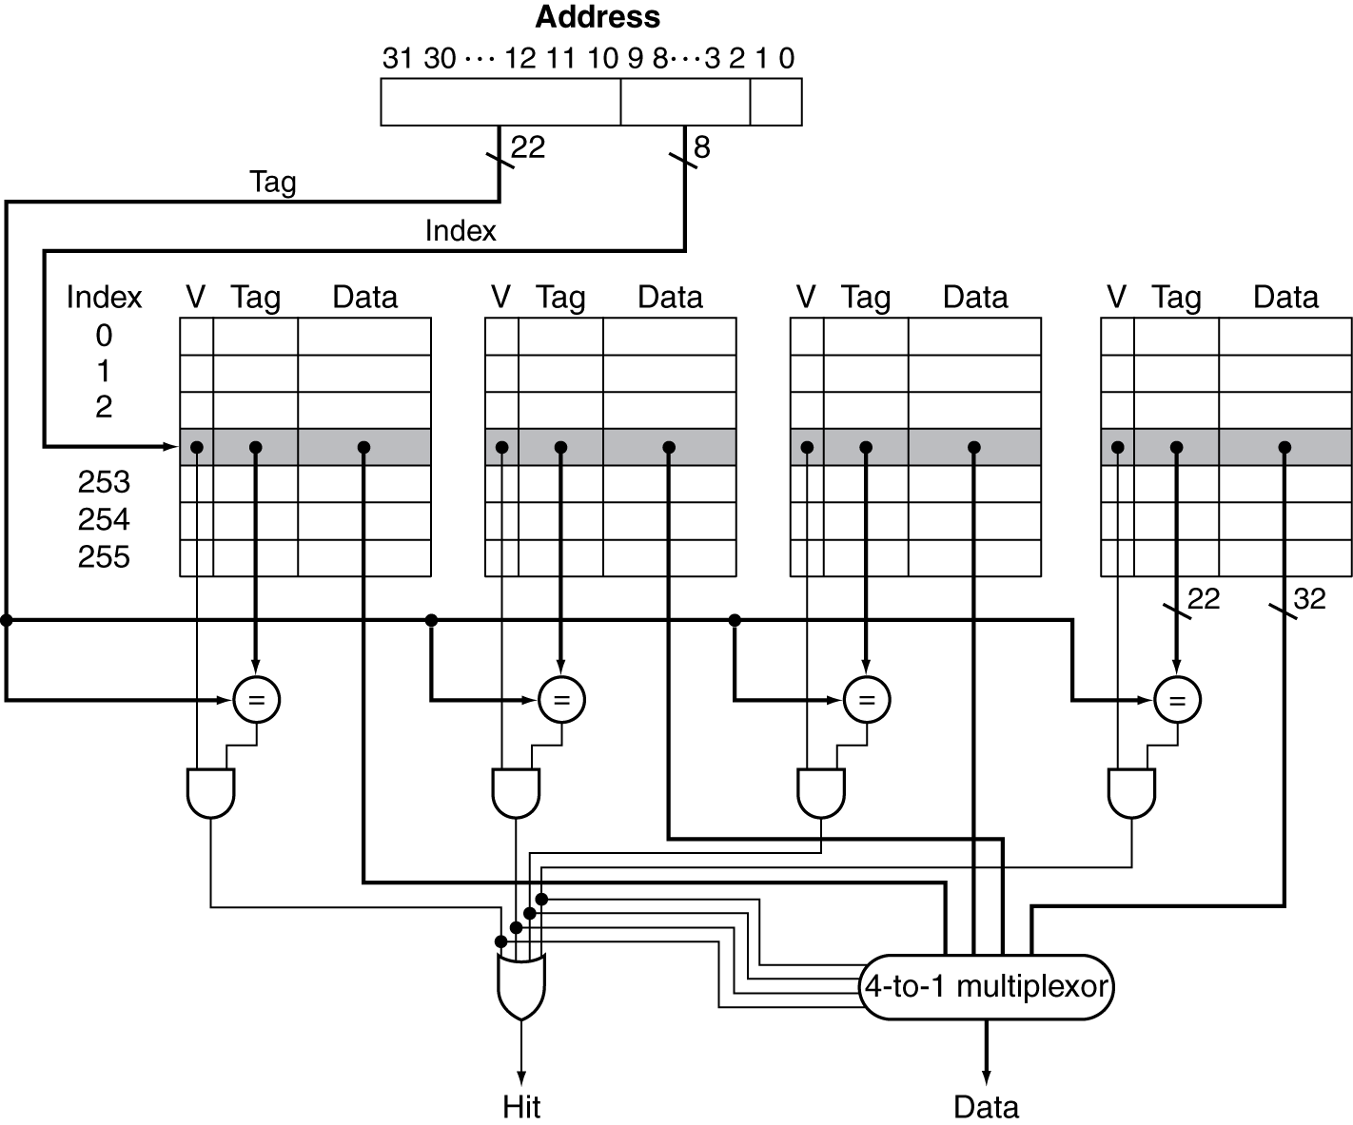
Set Associative Cache Organization
Computer Architecture, Spring 2020, AUT, Tehran, Iran

